Slide 1






AI Marketing Tools
Transform Your Marketing with Intelligent Automation
A comprehensive platform combining AI-powered chatbots, content generation, analytics, and campaign management to revolutionize your marketing strategy
AI Chatbot
Content Generation
Analytics
Campaigns

Slide 2

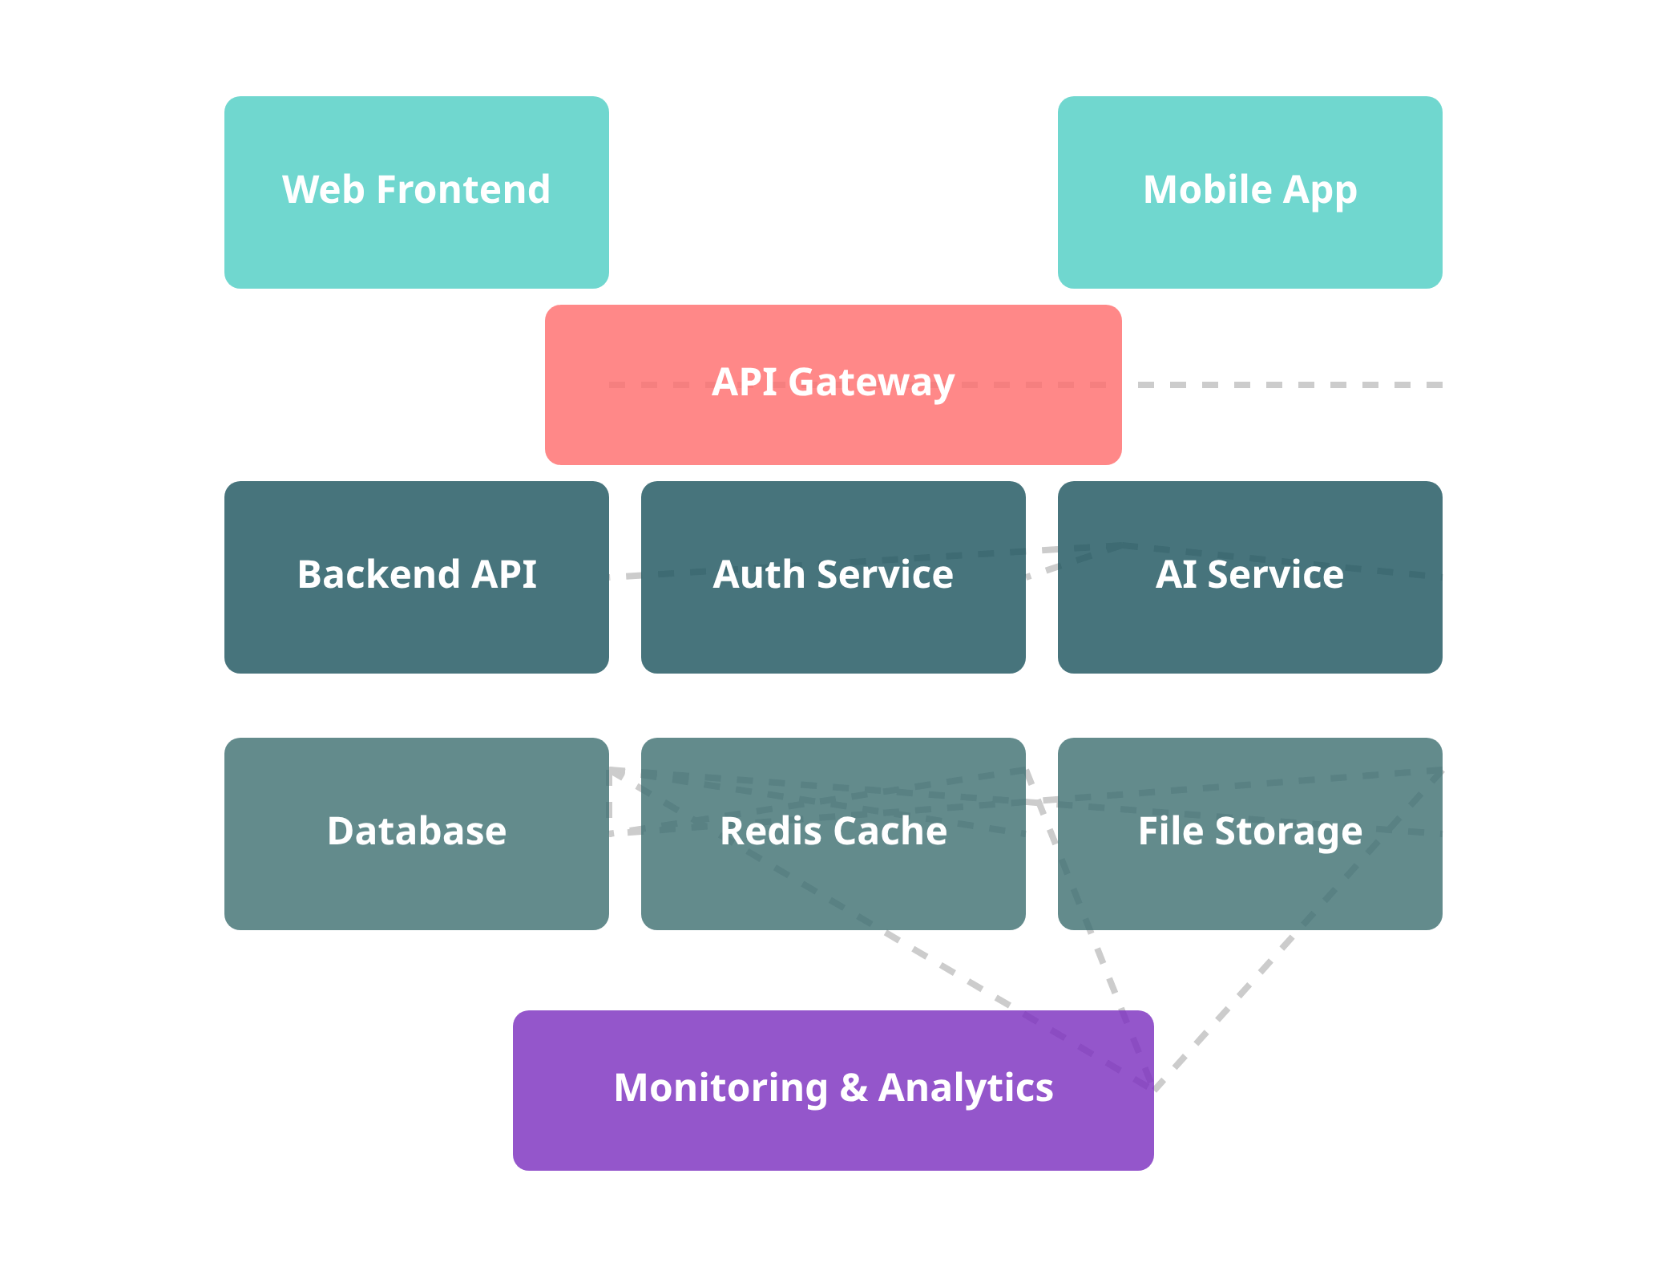














Platform Overview
Platform Components
Web Application
: Responsive React-based interface with
multilingual support and interactive dashboards
Mobile Application
: Cross-platform React Native app with
offline capabilities and native mobile features
Backend Services
: Scalable Flask microservices with RESTful
API, JWT authentication, and database integration
AI Components
: Advanced natural language processing,
content generation, and predictive analytics
Analytics Engine
: Real-time data processing, visualization, and
business intelligence
React
React Native
Flask
PostgreSQL
Redis
OpenAI
Docker
AWS
AI Marketing Tools
2

Slide 3






Key Features & Capabilities
AI Chatbot
Content Generation
Intelligent conversational agent with natural language understanding
AI-powered content creation for various marketing channels
Multilingual support (EN, ES, PAP, NL)
Blog posts, social media, email campaigns
Customizable personality and knowledge base
SEO optimization and tone adjustment
Analytics & Insights
Campaign Management
Comprehensive data analysis and visualization tools
End-to-end campaign creation, execution, and analysis
Real-time performance tracking
Email, social media, and ad campaigns
AI-powered recommendations
Performance tracking and optimization
AI Marketing Assistant
Hello! I'm your AI marketing assistant. How can I help you today?
What marketing strategies would you recommend for my small business?
AI Marketing Tools
3

Slide 4
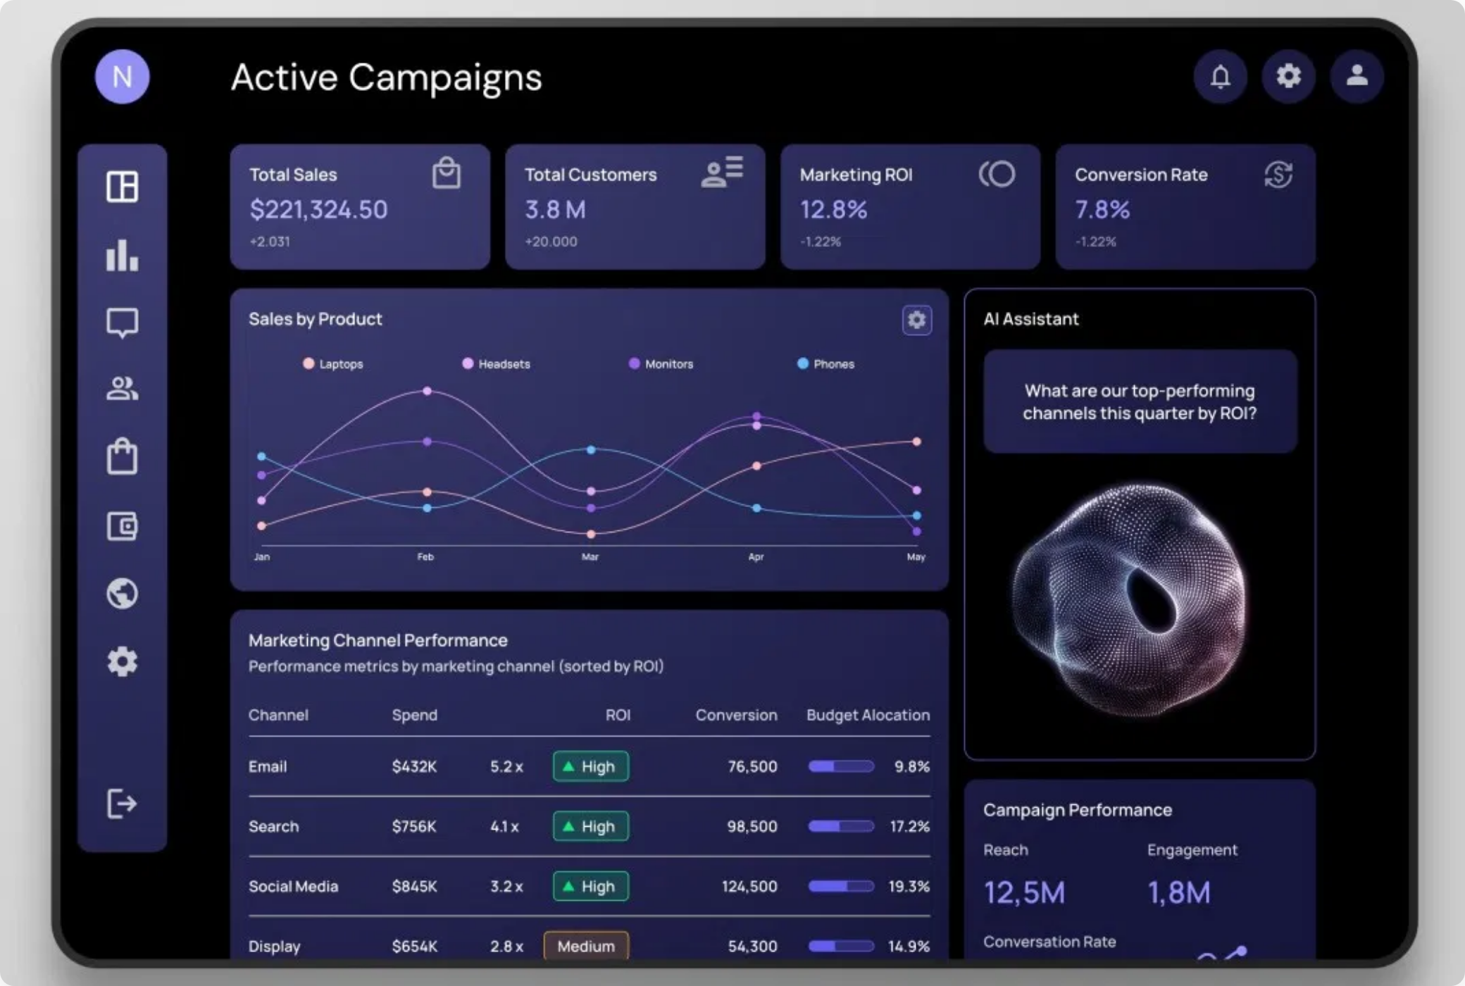









Web Application
Key Features
Responsive Design
: Optimized for all devices with mobile-
first approach and adaptive layouts
Multilingual Support
: Full localization in English, Spanish,
Papiamentu, and Dutch with easy language switching
Interactive Dashboards
: Real-time analytics with
customizable widgets and data visualization
Integrated Chatbot
: AI assistant accessible throughout the
application with conversation history
Secure Authentication
: Role-based access control with JWT
authentication and secure data handling
React
JavaScript
TailwindCSS
Chart.js
i18n
AI Marketing Tools
4

Slide 5


















Mobile Application
Key Features
Cross-Platform
: Native experience on iOS and Android with a
single codebase
AI Marketing
AI Marketing
Offline Support
: Continue working without internet connection
with automatic sync
Push Notifications
: Real-time alerts for campaign
performance and customer interactions
Mobile-Specific Tools
: QR code scanner, voice notes, and
location-based insights
Seamless Integration
: Full feature parity with web
application and real-time data sync
React Native
JavaScript
Expo
AsyncStorage
AI Marketing Tools
5

Slide 6

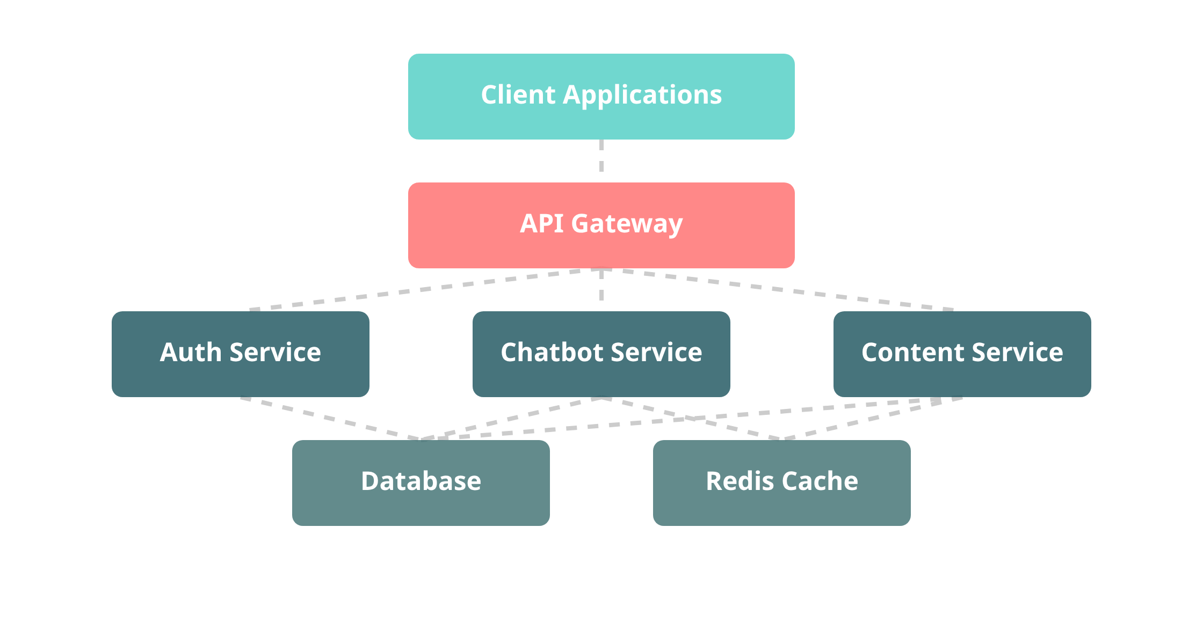







Backend Services & API
API Architecture
Backend Features
Microservices Architecture
: Scalable, maintainable services
with clear separation of concerns
JWT Authentication
: Secure token-based authentication with
role-based access control
Database Integration
: PostgreSQL for relational data with
Redis caching for performance
AI Integration
: OpenAI API integration for chatbot, content
generation, and analytics
API Usage Example
Key API Endpoints
// Send a message to the chatbot
const
sendMessage =
async
() => {
const
GET
/api/v1/chatbots
response =
await
fetch(
'/api/v1/chatbots/3/message'
, { method:
'POST'
, headers:
POST
/api/v1/chatbots/{id}/message
{
'Content-Type'
:
'application/json'
,
'Authorization'
:
'Bearer ${token}'
}, body:
JSON.stringify({ message:
'What marketing strategies do you recommend?'
,
GET
/api/v1/analytics/dashboard
session_id:
'user_session_123'
}) });
const
data =
await
response.json();
console.log
(data.message); };
POST
/api/v1/content/generate
PUT
/api/v1/campaigns/{id}
Flask
SQLAlchemy
JWT
Redis
OpenAI
AI Marketing Tools
6

Slide 7


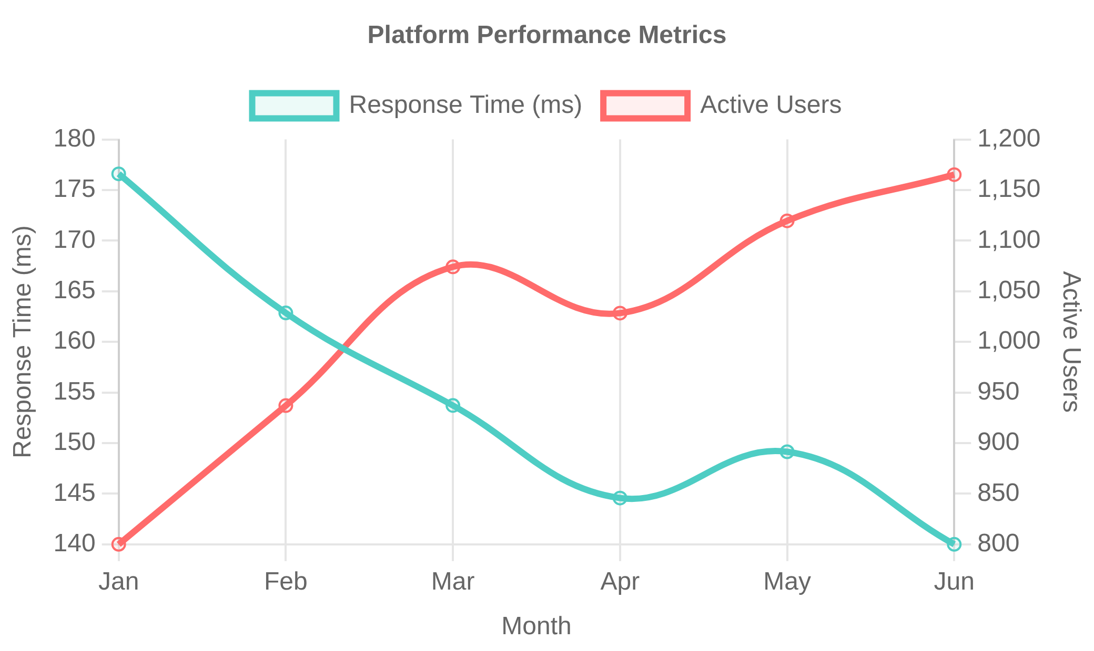



Analytics & Monitoring
Performance Dashboard
Monitoring Features
Real-Time Analytics
: Live performance tracking with
customizable dashboards and alerts
Health Monitoring
: Continuous system health checks with
automated incident detection
User Behavior Analysis
: Detailed insights into user
interactions and engagement patterns
AI-Powered Insights
: Machine learning algorithms for
predictive analytics and optimization
Smart Alerting
: Intelligent notifications with configurable
thresholds and escalation
Data Retention
: Long-term data storage with historical
99.8%
150ms
analysis and trend identification
Uptime
Avg Response
1.2K
4.7/5
Active Users
User Rating
AI Marketing Tools
7

Slide 8
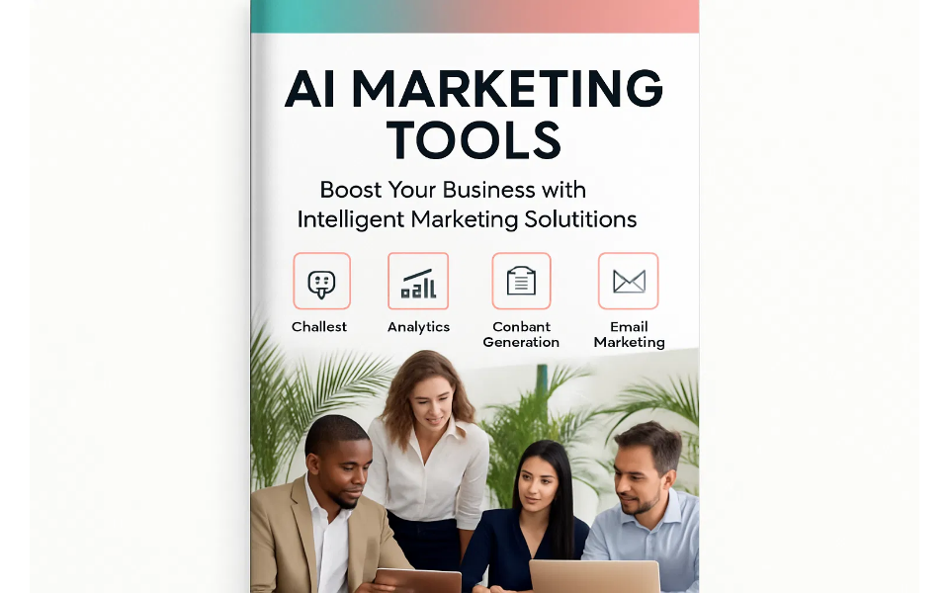
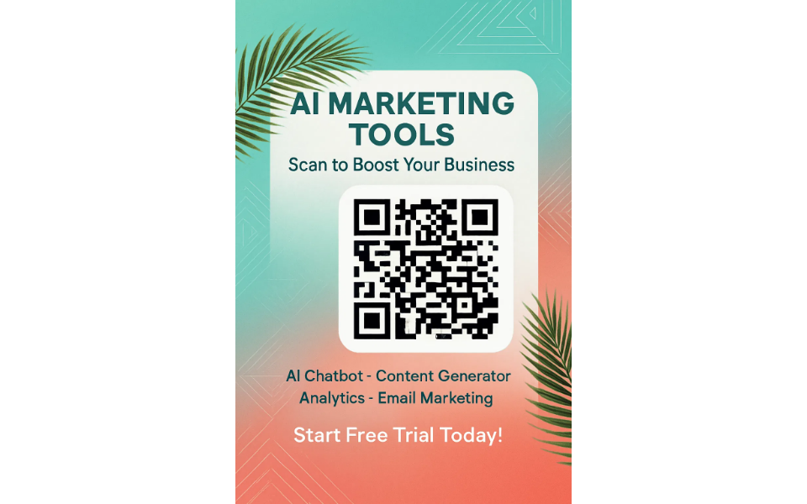




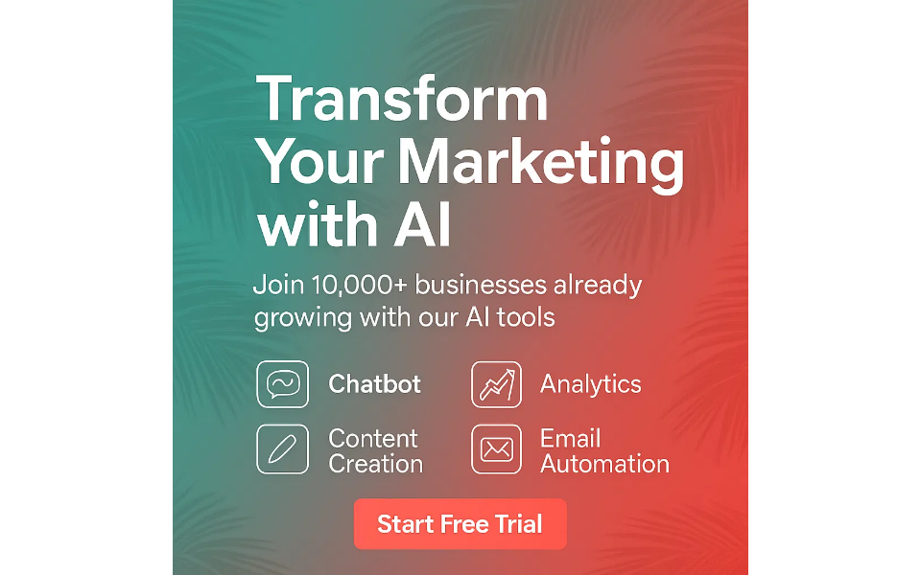


Marketing Materials & Assets
Visual Assets
Key Highlights
Consistent Brand Identity
: Cohesive visual language across
all materials with tropical modern aesthetic
Multilingual Support
: Designed for global reach with
content adaptable to various languages
Print & Digital Ready
: High-resolution assets suitable for
Professional Tri-Fold Brochure
Tropical QR Code Flyer
both print and online distribution
Comprehensive Strategy
: Supported by a 15-page marketing
strategy document covering audience, pricing, and channels
Data-Driven Design
: Visuals informed by market research
and target audience preferences
Social Media Post Example
Website QR Code
AI Marketing Tools
8

Slide 9

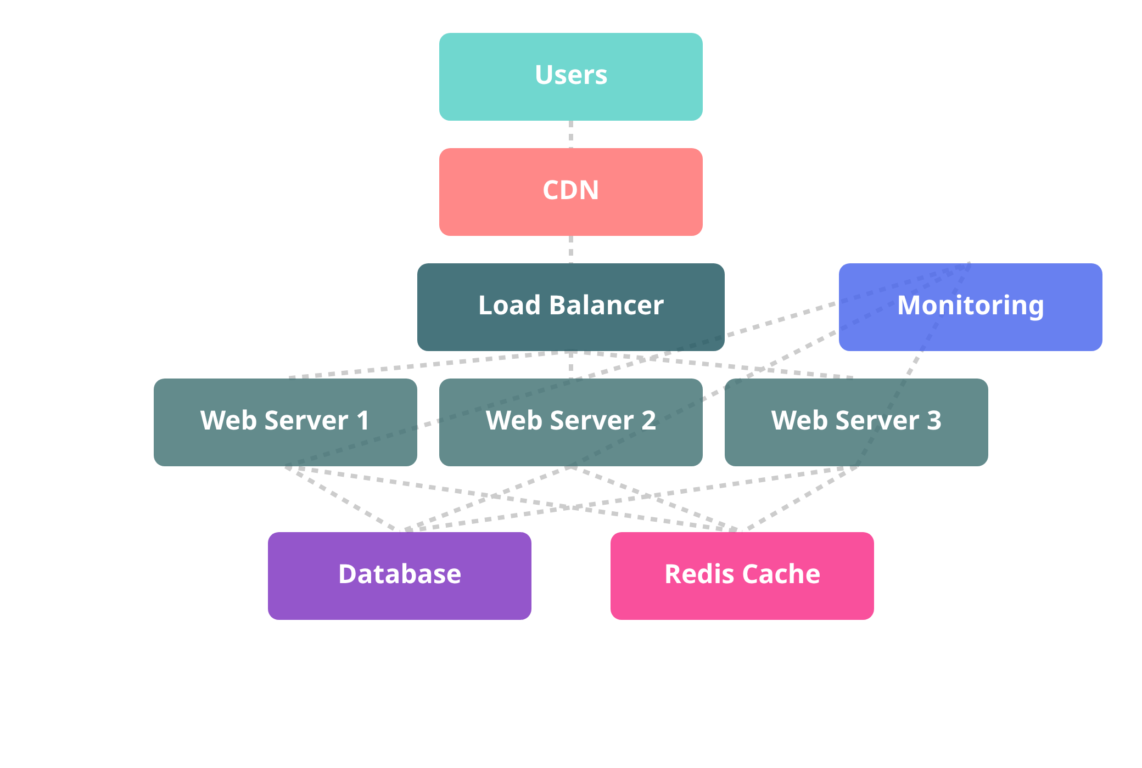






Deployment & Hosting
Infrastructure Architecture
Deployment Features
Containerized Deployment
: Docker containers for
consistent environments across development and production
Security & SSL
: HTTPS encryption, security headers, and
automated certificate management
Auto-Scaling
: Horizontal scaling based on demand with load
balancing and health checks
CI/CD Pipeline
: Automated testing, building, and deployment
with GitHub Actions integration
Data Backup
: Automated daily backups with point-in-time
recovery and disaster recovery plans
Performance Monitoring
: Real-time monitoring with alerting
Docker
Nginx
AWS
SSL/TLS
Monitoring
and performance optimization
AI Marketing Tools
9

Slide 10



Future Roadmap
Development Timeline
Strategic Priorities
Q1 2024
AI Enhancement
: Continuous improvement of AI models
Advanced AI conversation flows
Global Expansion
: Support for additional languages and
Enhanced multilingual support
localized strategies
Q2 2024
Integration Ecosystem
: Seamless connectivity with popular
Video content generation
platforms
Advanced analytics dashboard
Enterprise Security
: Advanced security features and data
protection
Q3 2024
Advanced Analytics
: Predictive analytics and AI-powered
AI-powered A/B testing
business insights
Social media automation
Community Building
: Developer community and partner
Q4 2024
program
Machine learning optimization
Global expansion features
AI Marketing Tools
10

Slide 11







Thank You
AI Marketing Tools represents the future of intelligent marketing automation, combining cutting-edge AI technology with user-friendly design to transform how businesses engage with their customers.
Get Started
Schedule Demo
Partner With Us
Begin your AI marketing journey with our comprehensive platform
Experience the power of AI-driven marketing automation
Join our ecosystem and grow your business with AI
www.aimarketingtools.com
hello@aimarketingtools.com
+1 (555) 123-4567

